Slide 1
Java Programming
Conditionals
分支语句

Slide 2
CalcArea.java (final version)
package edu.hit.java.intro;
import java.util.Scanner;
public class CalcArea{ public static void main(String[] arguments) { Scanner in = new Scanner(System.in); System.out.println(“how many inches?”); float r = in.nextFloat(); String str = “The circular area with radius ”; str = str + r + “ is %.3f\n”; System.out.println(str, Math.PI*r*r); } }
Notes:
看这段程，共有六条语句，这六条语句依次按顺序执行，那么能否跳过一些语句执行能?

Slide 3
Outline
BMI problem
Control structures
Conditional statements
Block
If statement
BodyMassIndex.java
Blackbox and Contract
Javadoc comments
Recursion
Switch statement
Notes:
Knowledge points Review:
Static Method
Method name
Return type
Parameters
Return statement
Method invocation
Arguments
Parameters Passing
Local variables

Slide 4
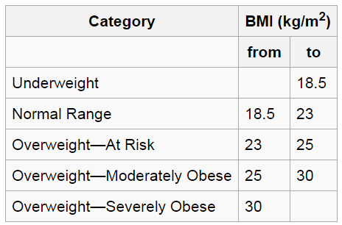
Body Mass Index (BMI)
The BMI is defined as the body mass divided by the square of the body height. The Hospital Authority of Hong Kong recommends the use of the following BMI ranges.
check yourself ☺

Slide 5
Control structures(控制结构)
Control structures are special instructions that can change the flow of control.
There are two basic types of control structure: loops and branches.
Branches(分支) allow the computer to decide between two or more different courses of action by testing conditions that occur as the program is running.
Loops(循环) allow a sequence of instructions to be repeated over and over.

Slide 6
Blocks(语句块)
The block is the simplest type of structured statement. Its purpose is simply to group a sequence of statements into a single statement. The format of a block is:
{
STATEMENTS
}

Slide 7
Conditional statements(分支语句)
Only one branch
if (CONDITION) { STATEMENTS }
With two branches
if (CONDITION) { STATEMENTS } else { STATEMENTS }
The CONDITION in parentheses is a condition expression whose type must be boolean.

Slide 8
Example
int x=8;
if (x % 2 == 0) {
System.out.println(x+" is even");
} else {
System.out.println(x+" is odd");
}

Slide 9
Example
Note: The braces are optional for branches that have only one statement. So we can rewrite the previous example this way:
int x=8;
if (x % 2 == 0)
System.out.println(x+" is even");
else
System.out.println(x+" is odd");
Note: It’s better to use braces to avoid making mistakes.

Slide 10
Chaining and nesting
Chaining(链式)
if (CONDITION) { STATEMENTS } else if (CONDITION) { STATEMENTS } else { STATEMENTS }
Nesting(嵌套)
if (CONDITION) { STATEMENTS } else {
if (CONDITION) { STATEMENTS } else STATEMENTS
} }

Slide 11
Example
int x=9;
if (x > 0) {
System.out.println("x is positive");
} else if (x < 0) {
System.out.println("x is negative");
} else {
System.out.println("x is zero");
}
int x=9;
if (x > 0) {
System.out.println("x is positive");
} else {
if (x < 0) {
System.out.println("x is negative");
} else {
System.out.println("x is zero");
}
}
Note: It’s better to use chaining if possible, because it is more readable

Slide 12
Body Mass Index (BMI)
The BMI is defined as the body mass divided by the square of the body height. The Hospital Authority of Hong Kong recommends the use of the following BMI ranges.

Slide 13
Body Mass Index (BMI)
String s=“Underweight”;
if (bmi>18.5 && bmi<=23) s=“Normal Range”;
else if(bmi>23 && bmi<=25) s=“OverWeight-At risk”;
else if(bmi>18.5 && bmi<=30) s=“OverWeight-Moderately Obese”;
else if(bmi>30) s=“OverWeight-Severly Obese”;
System.out.print(“your BMI is %.2f, %s!”,bmi, s);

Slide 14
BodyMassIndex.java
import java.util.Scanner;
public class BodyMassIndex {
public static void main(String[] args) {
Scanner in = new Scanner(System.in); System.out.println(“height is ? meters”); double height= in.nextDouble(); System.out.println(“weight is ? kg”); double weight= in.nextDouble(); showCategory(calcBMI(height,weight));
}
public static double calcBMI(double m, double kg) {…}
public static void showCategory (doube bmi) {…}
}

Slide 15
BodyMassIndex.java
public static double calcBMI(double m, double kg) {
return kg/(m*m);
}
public static void showCategory(double bmi) {
String s=“Underweight”;
if (bmi>18.5 && bmi<=23) s=“Normal Range”;
else if(bmi>23 && bmi<=25) s=“OverWeight-At risk”;
else if(bmi>18.5 && bmi<=30) s=“OverWeight-Moderately Obese”;
else if(bmi>30) s=“OverWeight-Severly Obese”;
System.out.print(“your BMI is %.2f, %s!”,bmi, s);
}

Slide 16
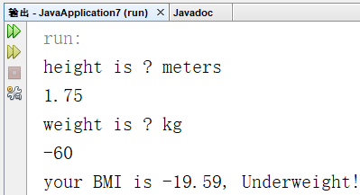
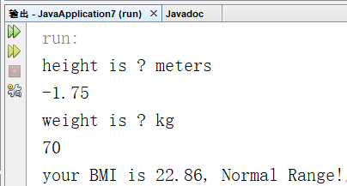
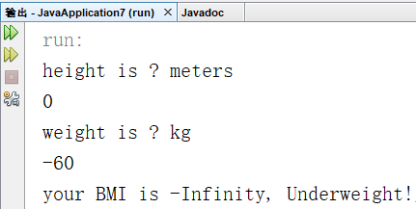
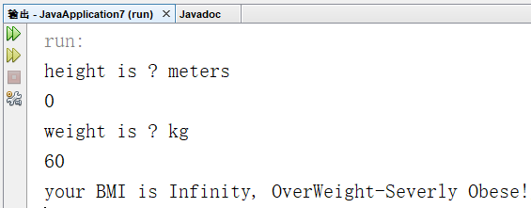
Well done?
If there is an input error, e.g. less than or equal to zero, what will happen?
Let’s test the code!
Notes:
注意浮点除法可能会产生溢出
How to solve this problem?
Modify the main method?
Or modify the BMI method?

Slide 17
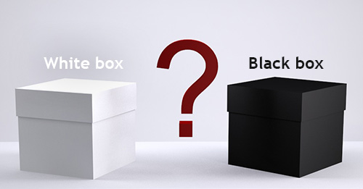
“black box”
A method is sometimes said to be a “black box”
A black box needs some kind of interface with the rest of the world, which allows some interaction between what’s inside the box and what’s outside.
To use a black box, you shouldn’t need to know anything about its implementation; all you need to know is its interface.
The interface of a black box should be fairly straightforward, well-defined, and easy to understand.
Notes:
The interface of a black box should be fairly straightforward, well-defined, and easy to understand.

Slide 18

“contract”
The interface also includes a specification of what the box does and how it can be controlled by using the elements of the interface.
we can refer to both parts of the interface—syntactic and semantic —collectively as the contract of the method.
A convenient way to express the contract of a subroutine is in terms of preconditions and postconditions.

Slide 19
Preconditions & postconditions
A precondition(前置条件) of a subroutine is something that must be true when the subroutine is called, if the subroutine is to work correctly.
For example,
for the built-in function Math.sqrt(x), a precondition is that the parameter, x, is greater than or equal to zero, since it is not possible to take the square root of a negative number.

Slide 20
Preconditions & postconditions
A postcondition(后置条件) is something that will be true after the subroutine has run (assuming that its preconditions were met—and that there are no bugs in the subroutine).
For example,
the postcondition of the function Math.sqrt() is that the square of the value that is returned by this function is equal to the parameter that is provided when the subroutine is called.

Slide 21
Preconditions & postconditions
Methods are sometimes described by comments that explicitly specify their preconditions and postconditions.
The comments are given in the form of Javadoc comments, but we can explicitly label the preconditions and postconditions.

Slide 22
Javadoc comments
begins with /** and ends with */
Javadoc comments can be used to describe methods, member variables, and classes. And they always immediately precede the thing it is commenting on.
Like any comment, a Javadoc comment is ignored by the computer when the file is compiled.
But there is a tool called javadoc that reads Java source code files, extracts any Javadoc comments that it finds, and creates a set of Web pages which can help us to understand how to use the methods.

Slide 23
Javadoc comments
There are many tags which can help the javadoc tool to create nicely formatted, interlinked web pages from the Javadoc comments.
Some frequently used tags are as follows:
@author
@version
@param
@return

Slide 24
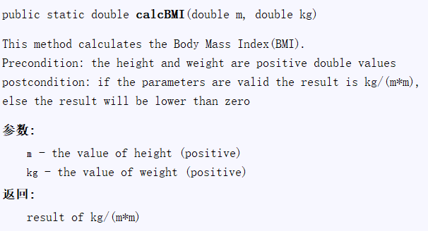
Javadoc comments
/**
* This method calculates the Body Mass Index(BMI).
* Precondition: the height and weight are positive double values
* postcondition: if the parameters are valid the result is kg/(m*m),
* else the result will be lower than zero
* @param m the value of height (>0)
* @param kg the value of weight (>0)
* @return result of kg/(m*m) */
public static double calcBMI(double m, double kg) {
if(m<=0 || kg<=0) return -1;
return kg/(m*m);
}

Slide 25
BodyMassIndex.java (modified)
import java.util.Scanner;
public class BodyMassIndex {
public static void main(String[] args) {
Scanner in = new Scanner(System.in);
System.out.println(“height is ? meters”);
double height= in.nextDouble();
System.out.println(“weight is ? kg”);
double weight= in.nextDouble();
double bmi = calcBMI(height,weight);
if(bmi>0) showCategory(bmi);
else System.out.println(“input error!”)
}
…
}

Slide 26
BodyMassIndex.java (modified)
import java.util.Scanner;
public class BodyMassIndex {
public static void main(String[] args) {
Scanner in = new Scanner(System.in);
System.out.println(“height is ? meters”);
double height= in.nextDouble();
System.out.println(“weight is ? kg”);
double weight= in.nextDouble();
if(weight >0 && height >0)
showCategory(calcBMI(height,weight));
else System.out.println(“input error!”)
}
…
}
Better!
Notes:
-1含义不明确，还有更好的办法，即通过exception来给出错误信息

Slide 27
Javadoc demo

Slide 28
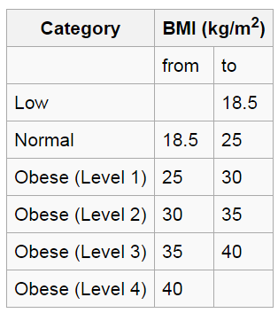
Well Done?
Assume the users of this program are from all over the world.
And in different country, the BMI ranges are different.
For example, Japan Society for the Study of Obesity recommends the following BMI ranges→.

Slide 29
BodyMassIndex.java
import java.util.Scanner;
public class BodyMassIndex {
public static void main(String[] args) {
Scanner in = new Scanner(System.in); System.out.println(“height is ? meters”); double height= in.nextDouble(); System.out.println(“weight is ? kg”); double weight= in.nextDouble(); showCategory(calcBMI(height,weight));
}
public static double calcBMI(double m, double kg) {…}
public static void showCategory (doube bmi) {…}
}

Slide 30
BodyMassIndex.java
public static double calcBMI(double m, double kg) {
return kg/(m*m);
}
public static void showCategory(double bmi) {
String region = getRegionID();
if(region.equals(“HK”)) showHongKongCategory(bmi);
else if(region.equals(“JP”)) showJapanCategory(bmi);
//else if …;
}
// assume this method can return the region ID
public static String getRegionID {…}
Notes:
https://en.wikipedia.org/wiki/ISO_3166-1_numeric

Slide 31
BodyMassIndex.java
public static void showHongKongCategory(double bmi) {
String s=“Underweight”;
if (bmi>18.5 && bmi<=23) s=“Normal Range”;
else if(bmi>23 && bmi<=25) s=“OverWeight-At risk”;
else if(bmi>25 && bmi<=30) s=“OverWeight-Moderately Obese”;
else if(bmi>30) s=“OverWeight-Severly Obese”;
System.out.printf(“your BMI is %.2f, %s!”,bmi, s);
}
public static void showJapanCategory(double bmi) {…}

Slide 32
Well done?
The users may be from all over the world, and there are different standards for the BMI ranges.
Should we define a new showXXXXCategory method if our program was sold in a new country?
Can we extend the program without modifying the code?
We will talk about this question in the future.
Notes:
在学习了collection frameworks及file等内容后，可实现更好的可扩展性，即在新的增加国家应用时，只需修改外部配置文件，而不修改程序代码！

Slide 33

Can a method call itself?

Slide 34

Recursion(递归)
Recursion in computer science is a method where the solution to a problem depends on solutions to smaller instances of the same problem.
Recursion occurs when a thing is defined in terms of itself or of its type.
There are not only recursive methods but also recursive classes.

Slide 35
Recursive method
A method which can call itself directly (or indirectly) is called recursive method.
The recursive method can be defined by two properties:
A simple base case (or cases)—a terminating scenario(递归终止条件) that does not use recursion to produce an answer
A set of rules(递归规则) that reduce all other cases (递归条件) toward the base case
The recursive method use conditional statements to check whether the cases are satisfied or not

Slide 36
Fibonacci numbers(斐波拉契数)
In mathematics, the Fibonacci numbers are the numbers in the following integer sequence, called the Fibonacci sequence, and characterized by the fact that every number after the first two is the sum of the two preceding ones:
1 , 1 , 2 , 3 , 5 , 8 , 13 , 21 , 34 , 55 , 89 , 144 , …
Often, especially in modern usage, the sequence is extended by one more initial term:
0 , 1 , 1 , 2 , 3 , 5 , 8 , 13 , 21 , 34 , 55 , 89 , 144 , …

Slide 37
Fibonacci number
The Fibonacci numbers is a classic example of recursion.
Basic cases
Fib(0)=0;
Fib(1)=1;
Recursion rules for other cases
For all integers n>1, Fib(n) = Fib(n-1)+Fib(n-2)

Slide 38
Fibonacci number
public static int fib(int n) { if (n == 0 || n==1) { return n; } else { return fib(n-1)+fib(n-2); } }

Slide 39
Factorial(阶乘)
In mathematics, the factorial of a non-negative integer n, denoted by n!, is the product of all positive integers less than or equal to n.
For example,
5 ! = 5 × 4 × 3 × 2 × 1 = 120.
The value of 0! is 1, according to the convention for an empty product

Slide 40
Factorial
Factorial is another classic example of recursion.
Basic cases
fact(0)=1;
Recursion rules for other cases
For all integers n>0, fact(n)=n*fact(n-1);

Slide 41
Factorial
public static int fact (int n) { if (n==0) { return 1; } else { return n*fact(n-1); } }

Slide 42
Well done?
Try it!
System.out.println(fact(20));
The result is -2102132736
The result should be 2432902008176640000
Notes:
Overflow上溢

Slide 43
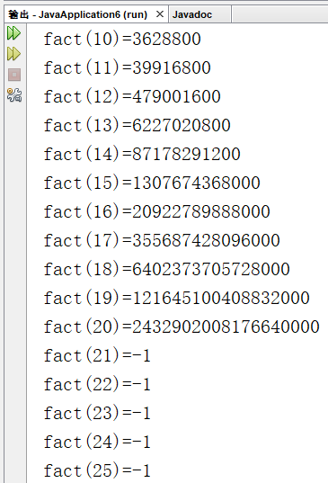
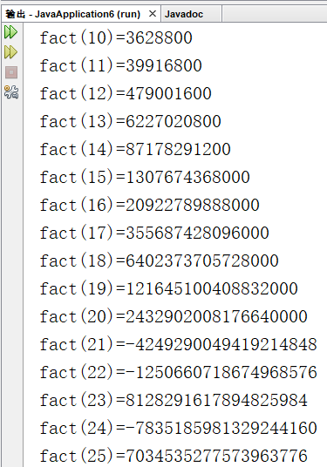
A better version
public static long fact (long n) {
if (n>20 || n<0) return -1;
if (n==0) {
return n;
} else {
return n*fact(n-1);
}
}
public static void main(String[] args) {
for(int i=10;i<=25;i++)
System.out.println("fact("+i+")="+fact(i));
}

Slide 44
Switch statement
switch EXPRESSION {
case CONSTANT1:
STATEMENTS1;
break;
case CONSTANT2:
STATEMENTS2;
break;
default:
STATEMENTS-Default;
}

Slide 45
Switch statement
A switch statement allows us to test the value of an expression and, depending on that value, to jump directly to some location within the switch statement.
The value of the expression can be one of below types:
int, short, byte, char, String, or enum.
In particular, note that the expression cannot be a double or float value.

Slide 46
Switch statement
The positions within a switch statement to which it can jump are marked with case labels that take the form: “case CONSTANT:”
CONSTANT is a literal of the same type as the expression in the switch.
As the final case in a switch statement you can, optionally, use the label “default:”

Slide 47
Switch statement
The break statements in the switch are technically optional. The effect of a break is to make the computer jump past the end of the switch statement, skipping over all the remaining cases.
If you leave out the break statement, the computer will just forge ahead after completing one case and will execute the statements associated with the next case label.

Slide 48
What is the output?
public static void main(String[] args){
byte a = 2;
switch(a){
case 1 : System.out.println(" A ");
case 2 : System.out.println(" B ");
case 3 : System.out.println(" C ");
case 4 : System.out.println(" D ");
default : System.out.println(" default ");
}
}

Slide 49
BodyMassIndex.java
public static void showCategory(double bmi) {
// assume this function can return the region ID
String region = getRegionID();
switch region{
case “HK”:
showHongKongCategory(bmi);
break;
case “JP”:
showJapanCategory(bmi);
break;
}
}
public static int getRegionID() {…}
Notes:
https://en.wikipedia.org/wiki/ISO_3166-1_numeric

Slide 50
Quiz
Define a method to determine whether a year is a leap year or a common year in the Gregorian calendar, the algorithm (pseudocode) is described below:
if (year is not divisible by 4) then (it is a common year)
else if (year is not divisible by 100) then (it is a leap year)
else if (year is not divisible by 400) then (it is a common year)
else (it is a leap year)

Slide 51


